Slide 1
👋 Hello gentlemen,
In this presentation, I will be introducing Active Directory and its deployment.

Slide 2
Key Objectives:
1. What is Active Directory?
2. What is Active Directory Domain Service (AD DS)?
3. Active Directory authentication mechanism.
4. Deployment and configuration of Active Directory

Slide 3
1. What Active Directory is
Active Directory developed by Microsoft, included in most Windows Server operating systems. It allows administrators to manage permissions and access to network resources, ensuring that users and computers can securely interact within a domain network.
Mian advantages of AD:
Centralized identity management: All users across the network can be configured from Active Directory with minimum effort.
Managing security policies: You can configure security policies directly from Active Directory and apply them to users and computers across the network as needed.

Slide 4
2. What is Active Directory Domain Service (AD DS)?
Active Directory Domain Service (AD DS) acts as a catalogue that holds the information of all of the "objects" such as users, groups, machines, printers, shares and many others.
Users
Users are one of the most common object types in Active Directory. Users can be used to represent two types of entities:
People: users will generally represent persons in your organization that need to access the network, like employees.
Services: you can also define users to be used by services like MSSQL. Every single service requires a user to run, but service users are different from regular users as they will only have the privileges needed to run their specific service.
Machines
Machines are another type of object within Active Directory; for every computer that joins the Active Directory domain, a machine object will be created.

Slide 5
Security Groups
assign access rights to files or other resources to entire groups instead
of single users.
Several groups are created by default:
Security Group | Description
Domain Admins | Users of this group have administrative privileges over the entire domain. By default, they can administer any computer on the domain, including the DCs.
Server Operators | Users in this group can administer Domain Controllers. They cannot change any administrative group memberships.
Backup Operators | Users in this group are allowed to access any file, ignoring their permissions. They are used to perform backups of data on computers.
Account Operators | Users in this group can create or modify other accounts in the domain.
Domain Users | Includes all existing user accounts in the domain.
Domain Computers | Includes all existing computers in the domain.

Slide 6
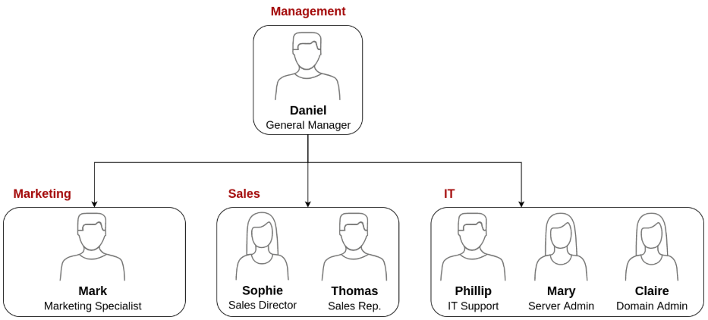

Slide 7
3. Active Directory authentication mechanism.
Kerberos is a secure authentication protocol used by Windows domains. Instead of sending passwords over the network, it uses tickets to prove a user’s identity after they log in once.
User requests a TGT
(Username + Timestamp encrypted with user password)
KDC issues TGT
(TGT encrypted with krbtgt hash + Session Key)
User requests a TGS
(TGT + Timestamp encrypted with Session Key + SPN)
KDC issues TGS
(TGS encrypted with Service Account hash + Service Session Key)
User accesses the service
(Presents TGS to the service)

Slide 8
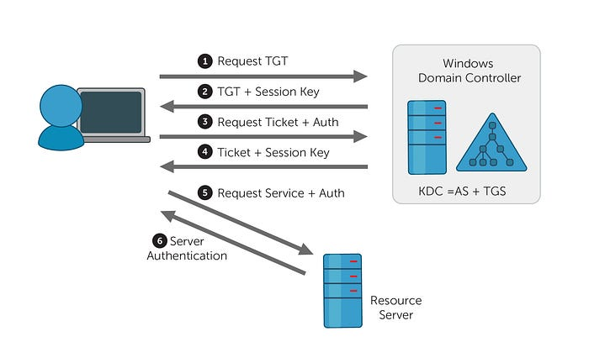

Slide 9
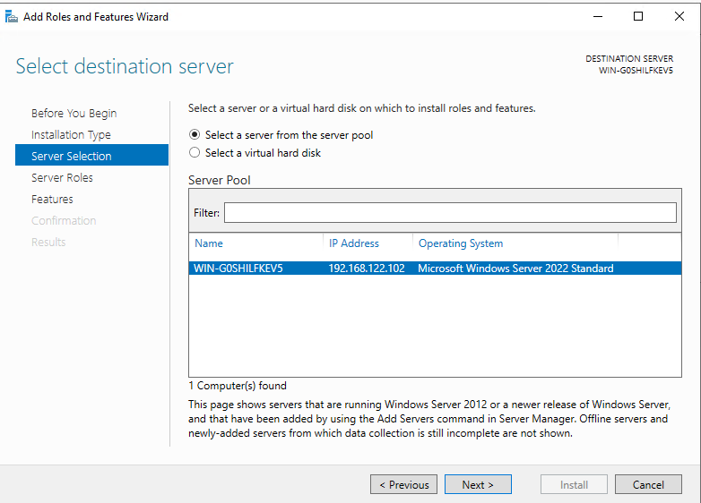
4. Setting up Active Directory
Open Server Manager Click Manage Select Add Roles and Features, A wizard will pop up named Add Roles and Features Wizard Choose Installation Type as Role-based or feature-based installation Select your server's name from the list.

Slide 10
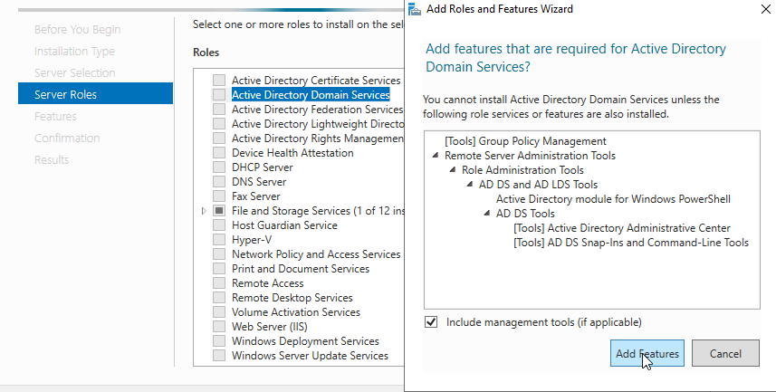
Check Active Directory Domain Services and Add Features

Slide 11
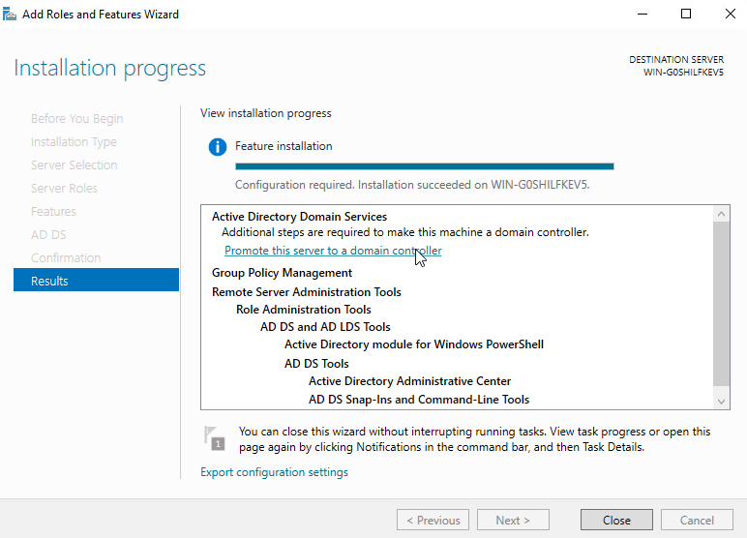
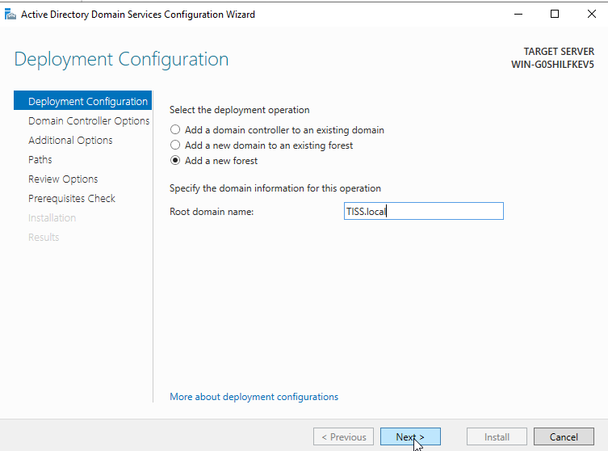
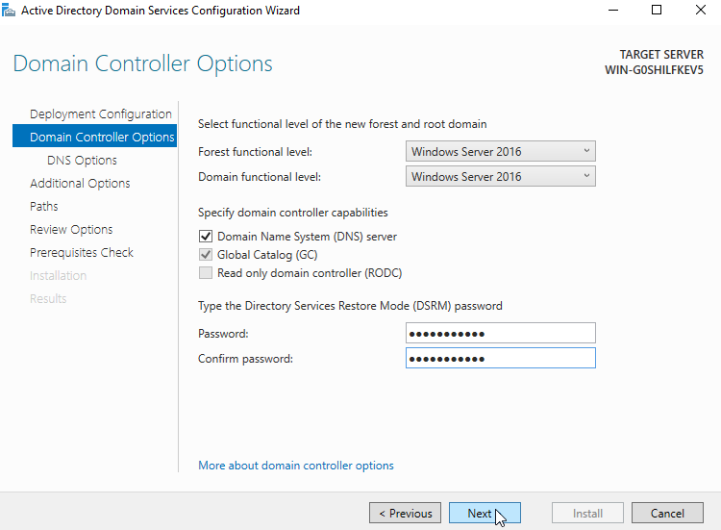
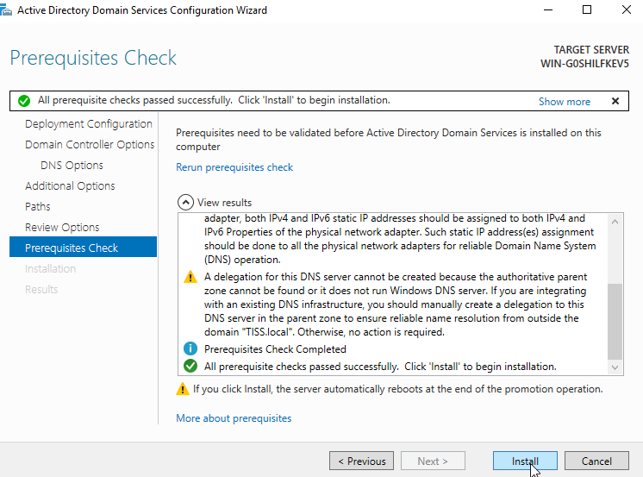
Click Promote this server to a domain controller
Choose Forest and name such my.com
Choose a strong password for AD
Click Install

Slide 12
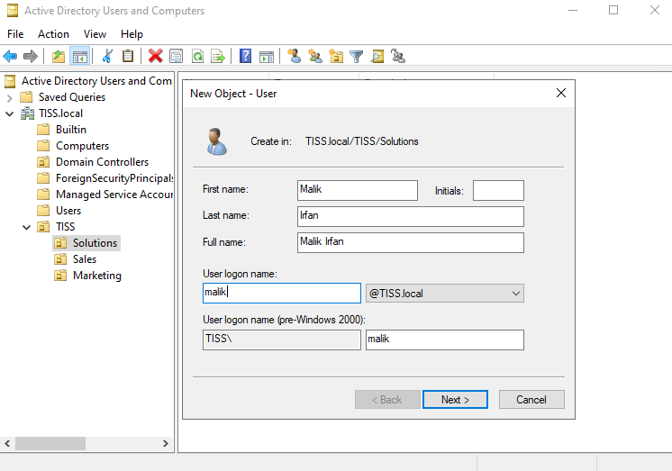
Create some OU and child OU add users/computers to them
Right click on any OU > New > User
Click Next choose a password for user and click Finish.

Slide 13
Thank you for your time!

